Slide 1
History Heroes
Term 2, Week 2

Slide 2
Question 1 (1 mark)
What was the name of one major black political movement/group active in the 1920s?

Slide 3
Question 2 (1 mark)
Who were Sacco and Vanzetti?

Slide 4
Question 3 (3 marks)
On what date were Sacco and Vanzetti executed (day, month, year)?

Slide 5
Question 4 (1 mark)
What was another name given to the Scopes Trial?

Slide 6
Question 5 (1 mark)
What was the Scopes Trial about?

Slide 7
ANSWERS

Slide 8
Question 1 (1 mark)
What was the name of one major black political movement/group active in the 1920s?
NAACP
UNIA

Slide 9
Question 2 (1 mark)
Who were Sacco and Vanzetti?
Italian-born labourers who were accused of being anarchists. They were arrested during the height of the Red Scare and charged with the murder of Parmenter and the guard.

Slide 10
Question 3 (3 marks)
On what date were Sacco and Vanzetti executed (day, month, year)?
24th August 1927

Slide 11
Question 4 (1 mark)
What was another name given to the Scopes Trial?
The Monkey Trial

Slide 12
Question 5 (1 mark)
What was the Scopes Trial about?
Challenging fundamentalist Christian views and teachings in schools. Scopes was a teacher who went against the law and taught students about non-Christian scientific findings.

Slide 13
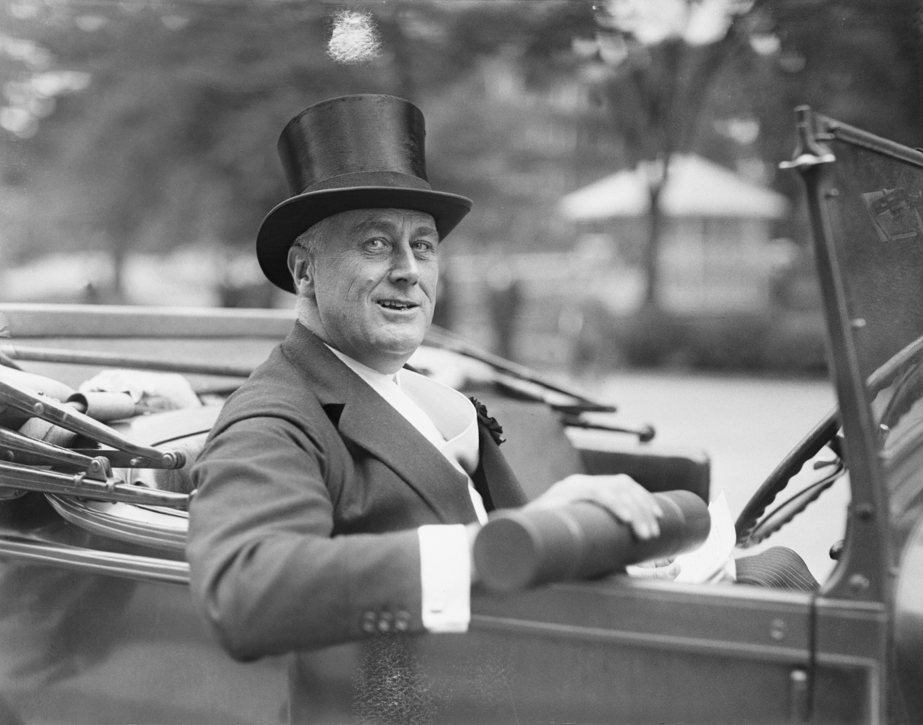
RESULTS??
/7

Slide 14
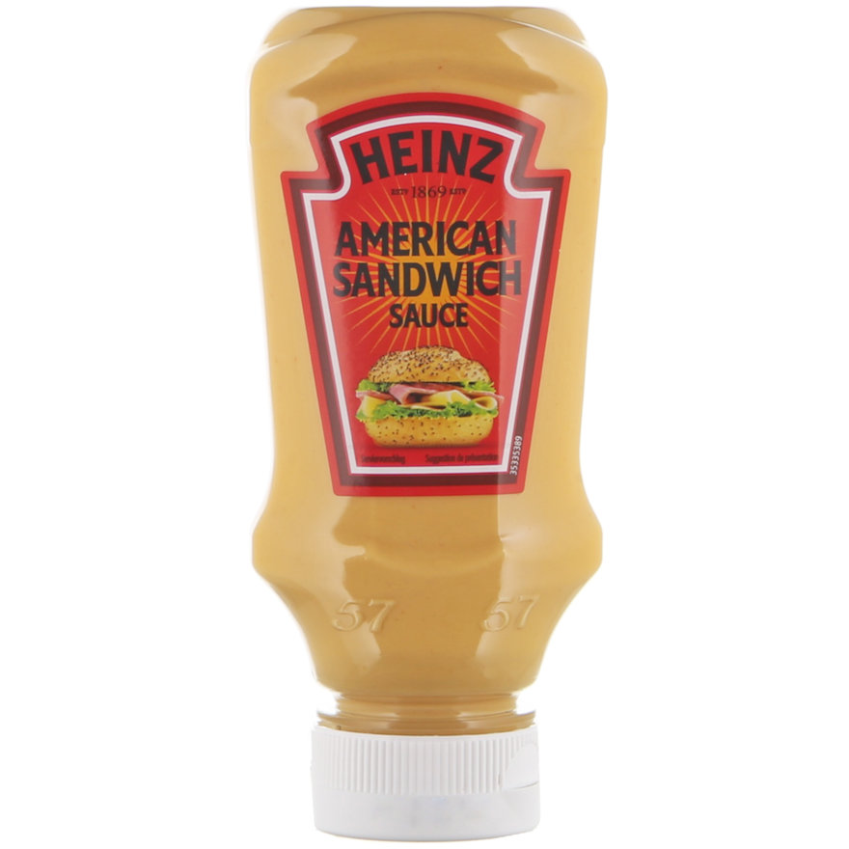
Source of the week

Slide 15
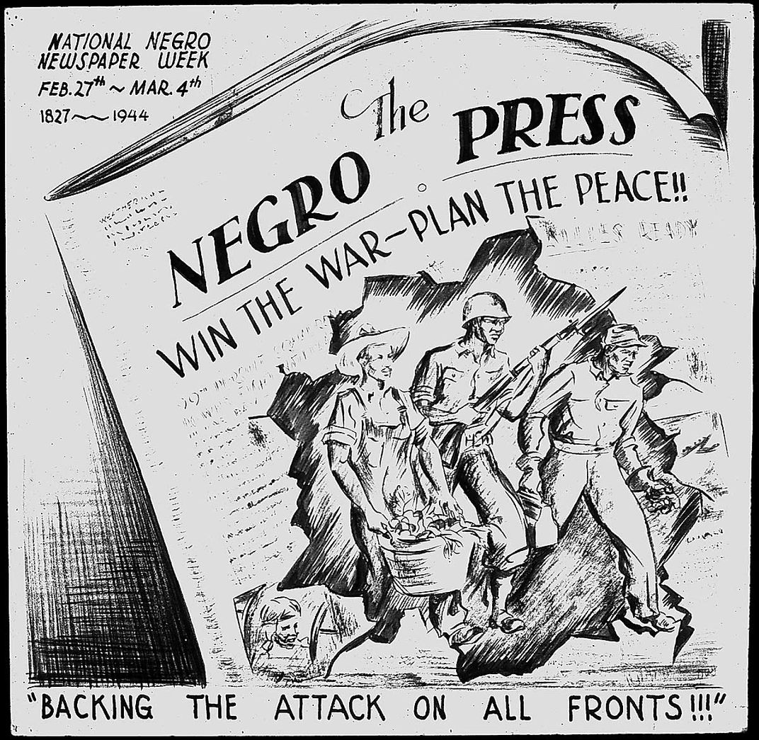
Creator: Charles Alston Date: 1944

